Slide 1
MACHINE LEARNING PROJECT
Land Cover Classification Using EuroSAT
Comparing SVM, Random Forest, and K-Nearest Neighbors on Satellite Imagery
Presented By
Sushil Sharma Subedi
Student ID
202652620003
Project Github link
Github Link

Slide 2
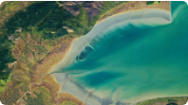
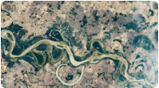
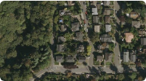
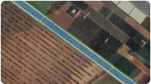
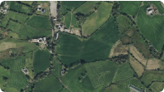
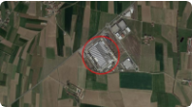
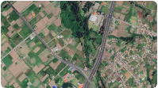
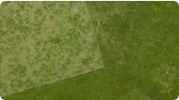
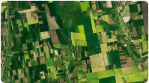
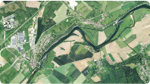
EuroSAT: 10 Land-Cover Categories
Visual samples representing the diverse classes in the dataset.
Sea / Lake
River
Residential
Permanent Crop
Herbaceous
Industrial
Highway
Pasture
Annual Crop
Forest

Slide 3
Problem Statement & Objectives
Why automate land-cover classification on satellite image collections?
The Problem
Project Goals
Satellite image collections contain numerous diverse land types. Manual sorting is slow, tedious, and inconsistent.
•
Build a robust supervised classification workflow.
•
Extract color and edge/shape features from image patches.
Example: Automating thousands of photos into Forest, Farmland, and Water folders.
•
Compare SVM, Random Forest, and KNN across performance metrics and training time.

Slide 4
Feature Extraction
Representing each image patch as a numerical feature vector (1,866 dimensions).
Color Histograms
HOG Descriptors
Combined Vector
32-bin histogram per RGB channel plus statistical moments (Mean & Std).
Histogram of Oriented Gradients measuring edges and structural shape patterns.
Concatenated spectral and HOG features unified for classical machine learning models.
1,764 dimensions capturing spatial layout.
1,866 total features per patch.
96 dimensions capturing spectral properties.

Slide 5
Dataset: EuroSAT Balanced Subset
Curated satellite image subset for efficient benchmaking.
10,000
10
64×64
1,000
Total Images
Land-Cover Classes
Pixels per Patch (RGB)
Images per Class

Slide 6
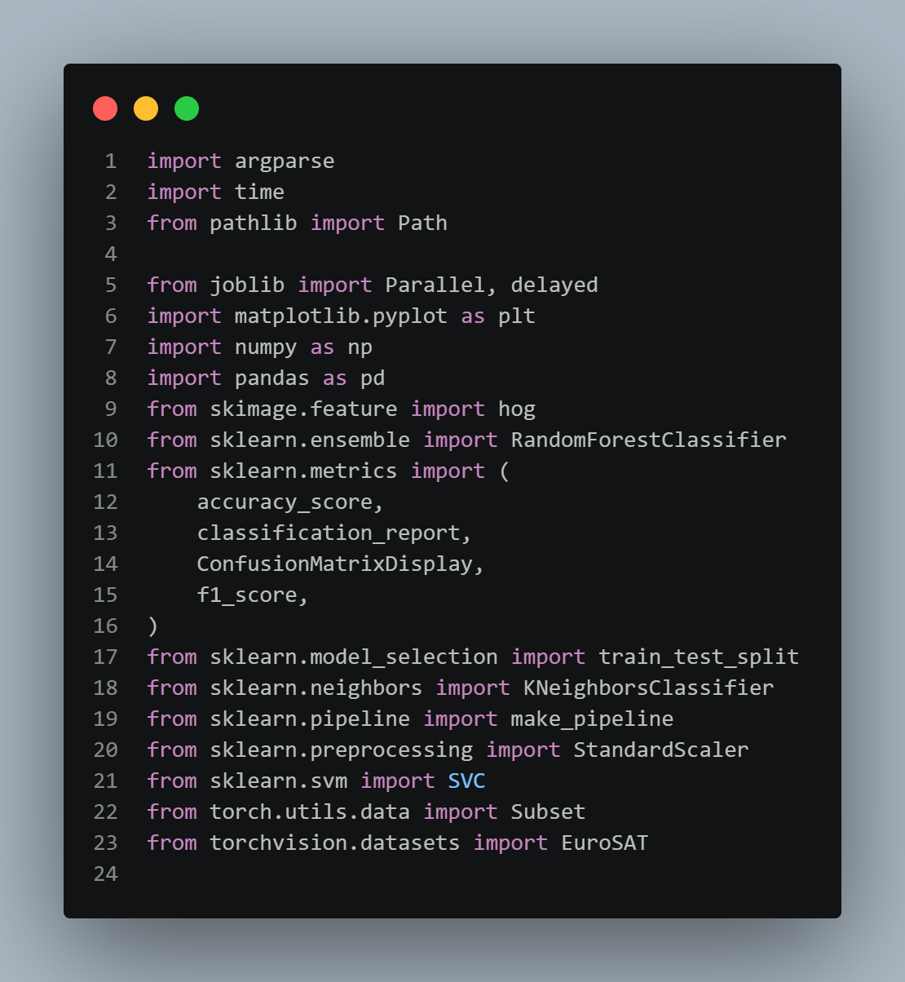
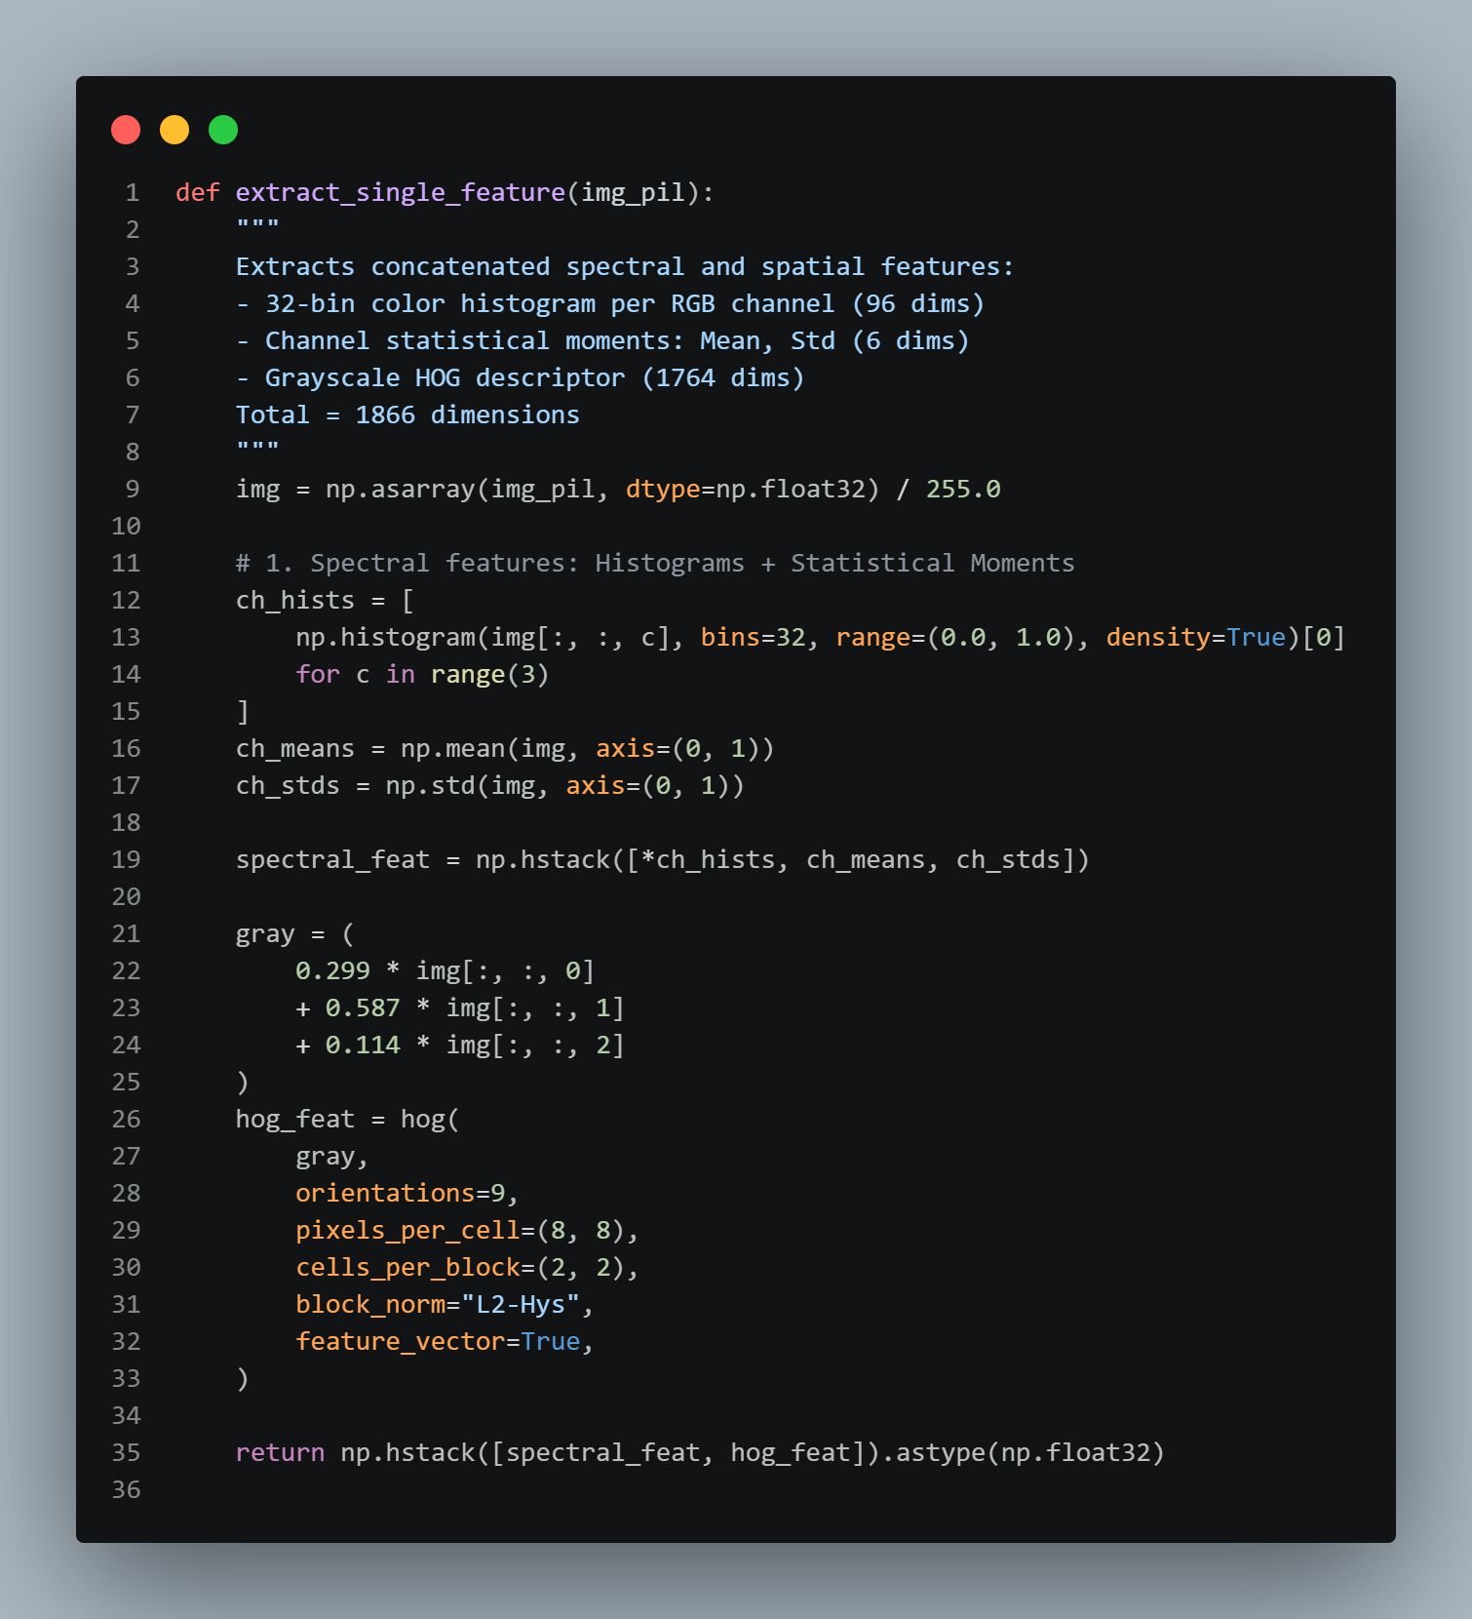
Implementation: Feature Extraction Code
Combining spectral color moments and HOG spatial descriptors.

Slide 7
Methodology & Data Split
A rigorous and consistent workflow across all models.
1. Data Partitioning
2. Pipeline Scaling
3. Reproducibility
80% Training (8,000 samples) and 20% Testing (2,000 samples) with stratification to preserve class proportions.
StandardScaler fitted strictly within SVM and KNN pipelines to prevent data leakage.
Configured with fixed random state (random_state=42) and parallel processing.

Slide 8
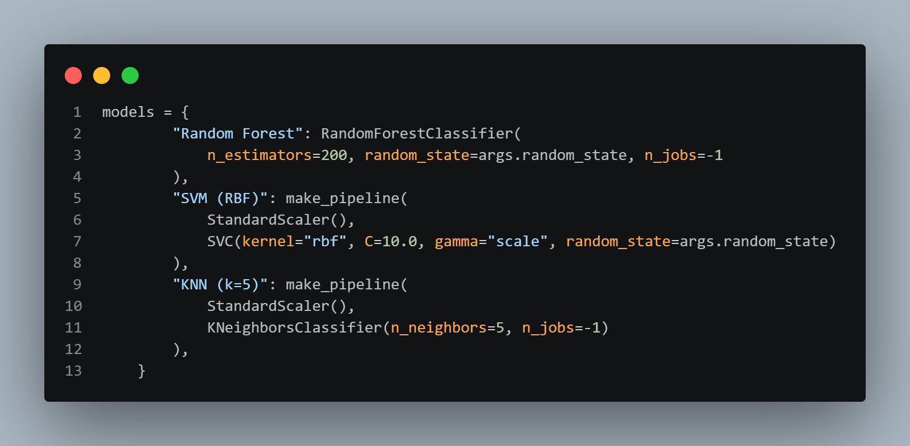
Implementation: Model Pipelines
Configuring pipelines for SVM, Random Forest, and KNN.

Slide 9
The Three Algorithms
Evaluating different learning paradigms on identical features.
Support Vector Machine
Random Forest
K-Nearest Neighbors
RBF kernel with C=10.0 and scaled features for non-linear boundaries.
Ensemble of 200 decision trees making decisions using feature rules.
Distance-based classification with k=5 and feature scaling.
Analogy: Draw optimal boundaries separating categories.
Analogy: Combine votes from many decision-makers.
Analogy: Query the 5 closest training examples.

Slide 10
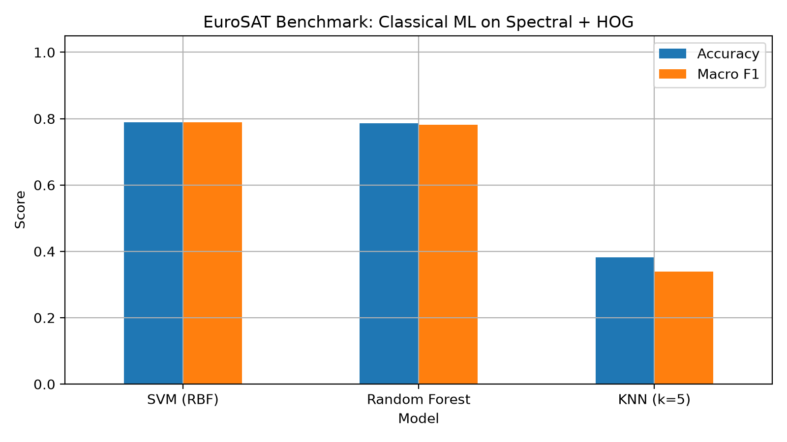
Results: Model Performance Comparison
Accuracy and Macro F1 scores across the 2,000-image test set.
SVM (RBF)
Accuracy: 78.85% | Macro F1: 78.85%
Training time: 35.83s (Highest accuracy)
Random Forest
Accuracy: 78.60% | Macro F1: 78.11%
Training time: 2.07s (Nearly identical accuracy, much faster)
KNN (k=5)
Accuracy: 38.15% | Macro F1: 33.94%
Training time: 0.16s (Fastest training, lower performance)

Slide 11
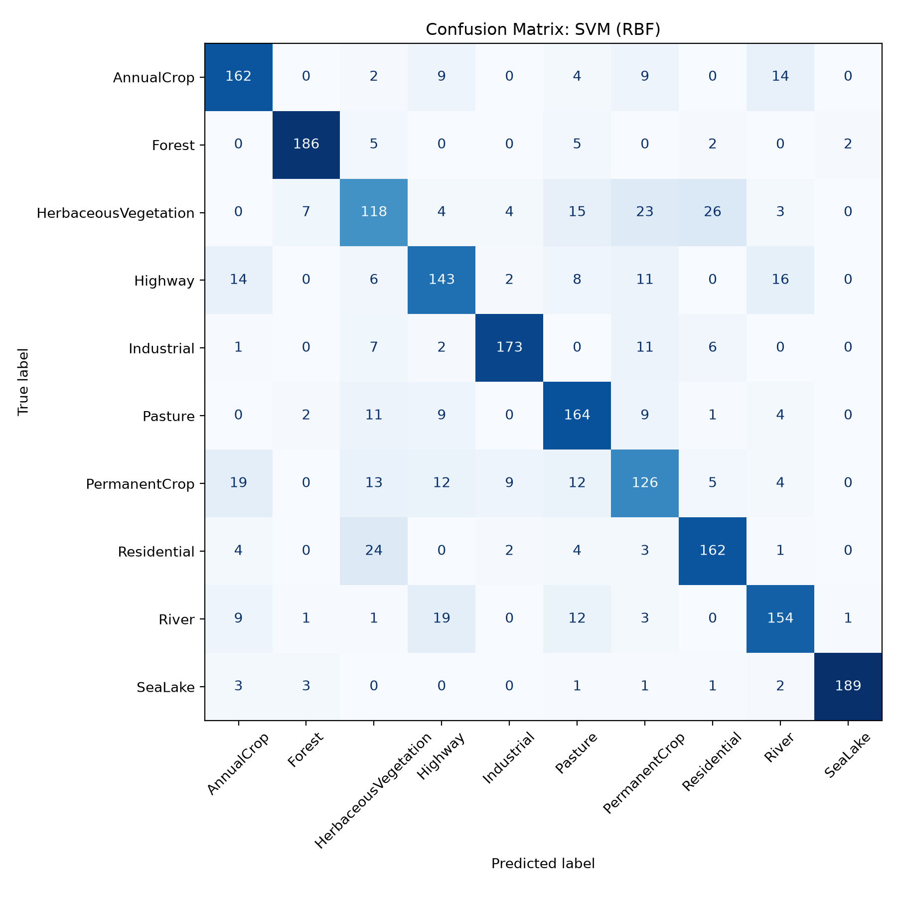
Confusion Matrix: SVM (RBF)
Detailed class-wise misclassifications and confusion patterns.

Slide 12
Conclusion & Takeaways
Traditional machine learning effectively classifies satellite land-cover images using engineered visual features.
SVM (78.85%)
Random Forest (78.60%)
Key Takeaway
Achieved the highest accuracy in this benchmark run.
Nearly identical accuracy with drastically faster training time.
Model choice depends on balancing accuracy, compute cost, and application goals.
Thank you! | Questions?

